Slide 1
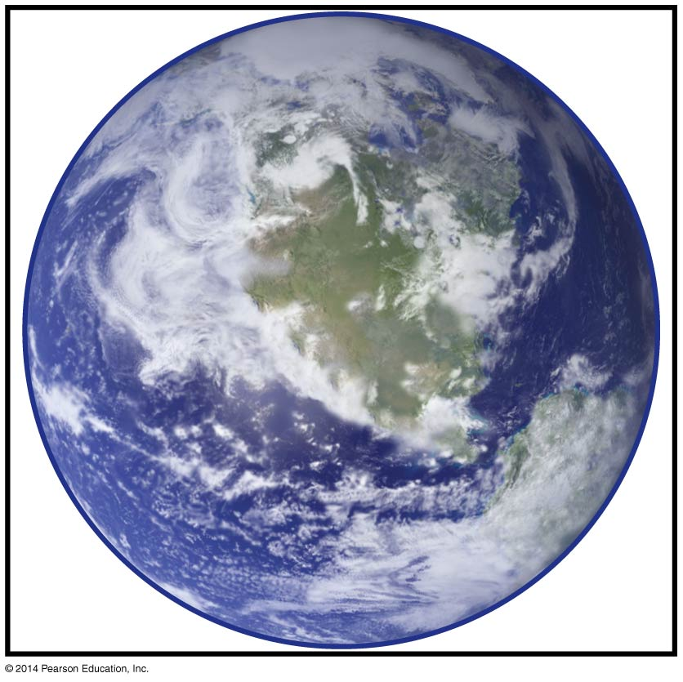
The Origin and Early
Evolution of Life
BT 454
Chapter 17
Notes:
Chapter 17 Opener

Slide 2
Life
What exactly do we mean by life? Life is difficult to define because it is a process, not a thing.
Life arose between 4.4 Ga, when liquid water appeared on Earth, and 3.5 Ga, when life was already present as judged from isotopic and fossil evidence.
life arose from a system that was capable of self-replication and that was subject to Darwinian evolution.
Self replication means that the system relied only on small molecules and energy for propagation.
Darwinian evolution means that the system was subject to mutation and modification, allowing for the appearance and selection of more complex, variant systems that propagated more efficiently.

Slide 3
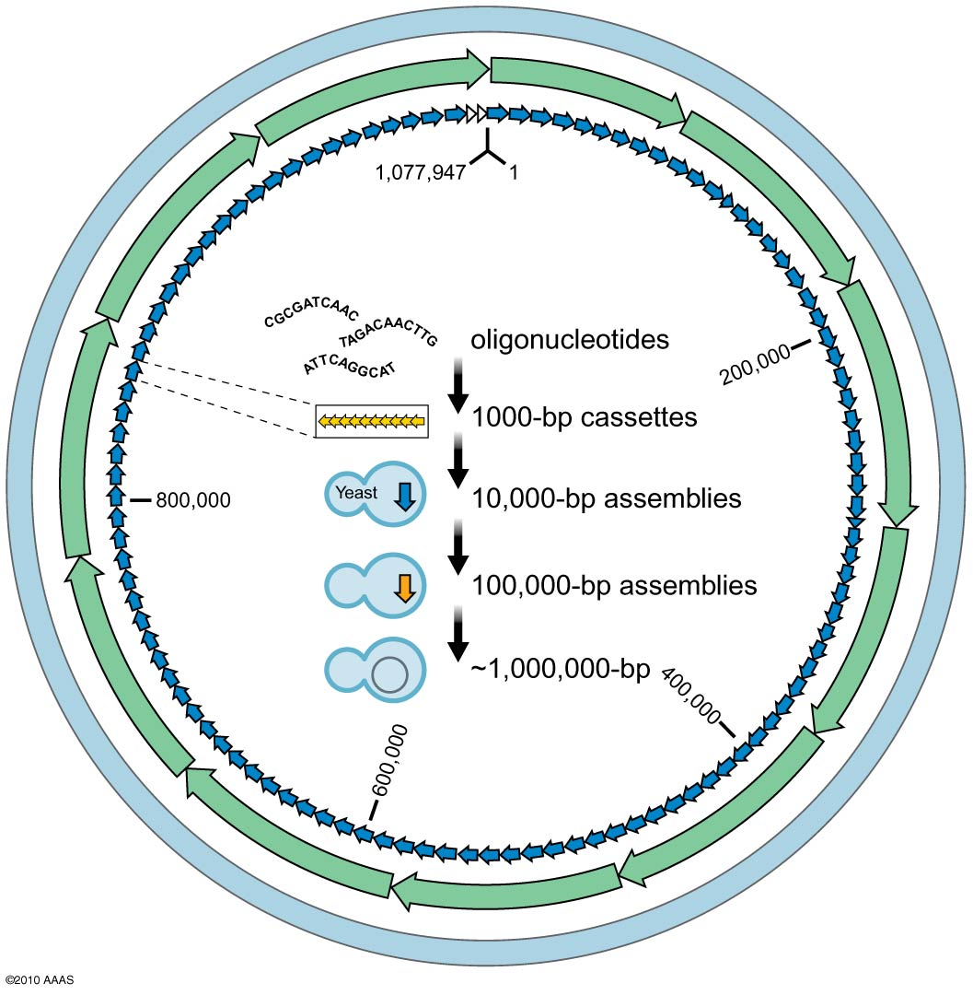
Among contemporary life-forms, the simplest, free-living organisms are members of the genus Mycoplasma.
These bacteria lack a cell wall and have tiny genomes as exemplified by the species Mycoplasma genitalium, which has a genome of 580 kilobases (kb), representing 500 protein-coding genes.
Transplantation process resulted in a free-living bacterium whose genome was created entirely by synthetic means.
Creating a synthetic genome:
The scheme shows the strategy used for the chemical synthesis of the complete genome of Mycobacterium mycoides. Cassettes of 1000 bp (yellow arrows) were assembled stepwise into increasingly longer units and, finally, into a complete artificial chromosome using yeast as a host cell.
Notes:
Figure 17-1
©2010 AAAS http://www.sciencemag.org/content/329/5987/52.abstract

Slide 4
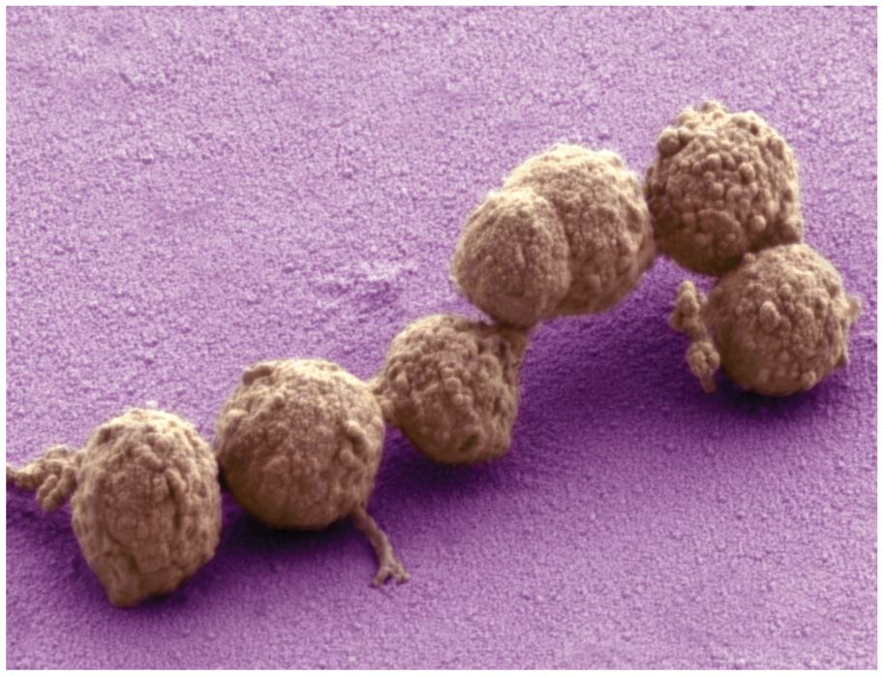
Living bacteria with a synthetic genome.
Notes:
Figure 17-2

Slide 5
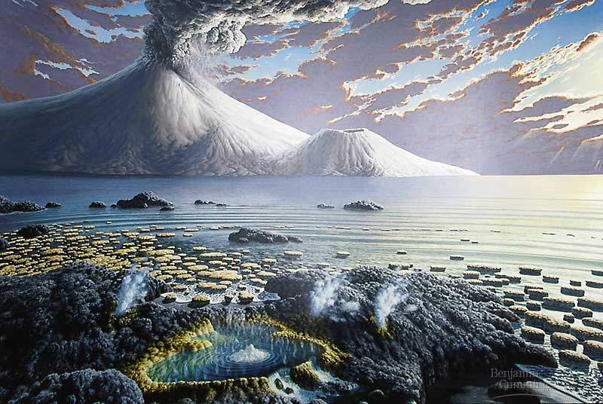

Slide 6
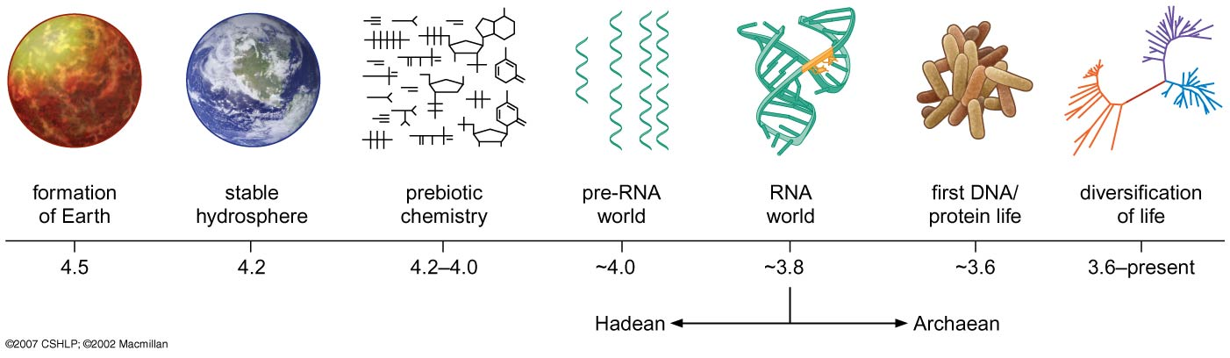
The geological eon from the formation of the Earth to 3.8 Ga, corresponding to the age of the oldest, well-preserved sedimentary rocks, is the Hadean.
It is followed by the Archaean eon, which ended at 2.5 Ga, roughly corresponding to the advent of an oxygen-containing atmosphere.
Isotopic studies of the mineral zircon indicate that oceans began to form no later than 4.4 Ga, resulting in a stable hydrosphere by 4.2 Ga in the Hadean eon, setting an early boundary for events leading to the origin of life.
Notes:
Figure 17-3
©2007 CSHLP; ©2002 Macmillan www.nature.com

Slide 7
What was the basis for Prebiotic Organic Chemistry?
The building blocks of life are organic molecules. If life arose spontaneously on Earth, then it must have done so from organic molecules that resemble the constituents of contemporary life.
In our Protein World, amino acids, sugars, nucleotides, and lipids are produced by enzymes in complex, multistep biosynthetic pathways.
Where did the organic building blocks of life come from before there was life???
Miller and Urey subjected water, methane, ammonia, and hydrogen to electrical discharges in sealed flasks.
Within a week, a significant portion of the methane was converted into organic molecules including a racemic mixture of 11 amino acids.

Slide 8
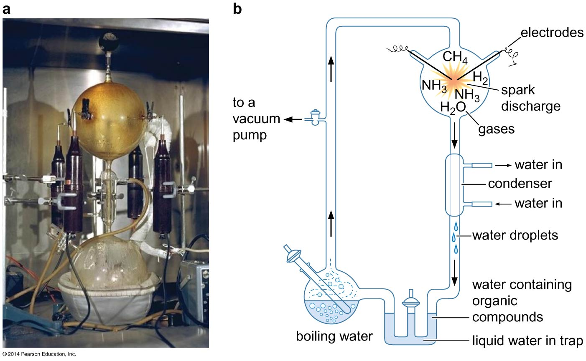
The Miller–Urey experiment (1953)
Notes:
Figure 17-4

Slide 9
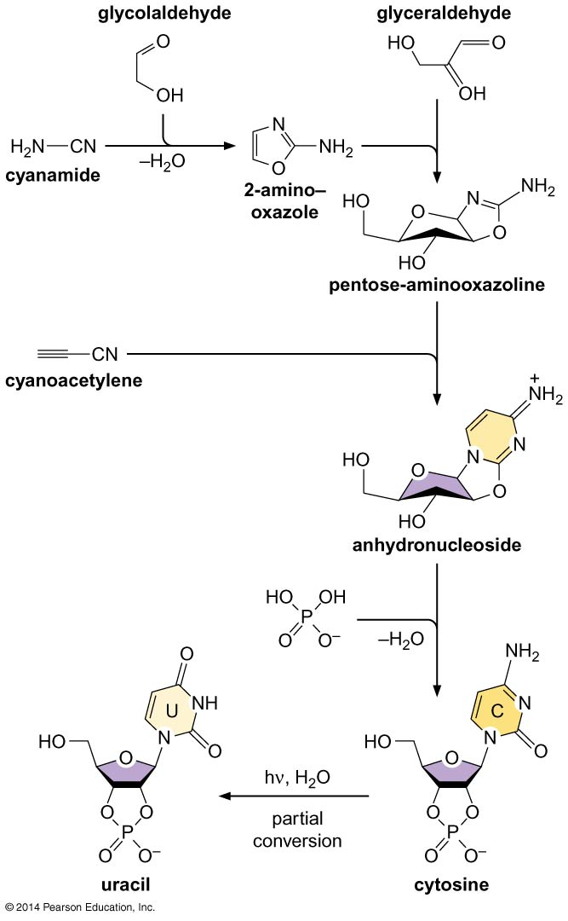
Despite the success of the iconic experiments of Miller and Urey, efforts to mimic the conditions of prebiotic chemistry have not until recently succeeded in generating the building blocks of polynucleotides.
However, nucleotides have now been created via a new approach involving four simple organic molecules (cyanamide, cyanoacetylene, glycolaldehyde, and glyceraldehyde) that are readily produced under plausible prebiotic conditions
Notes:
Figure 17-5

Slide 10
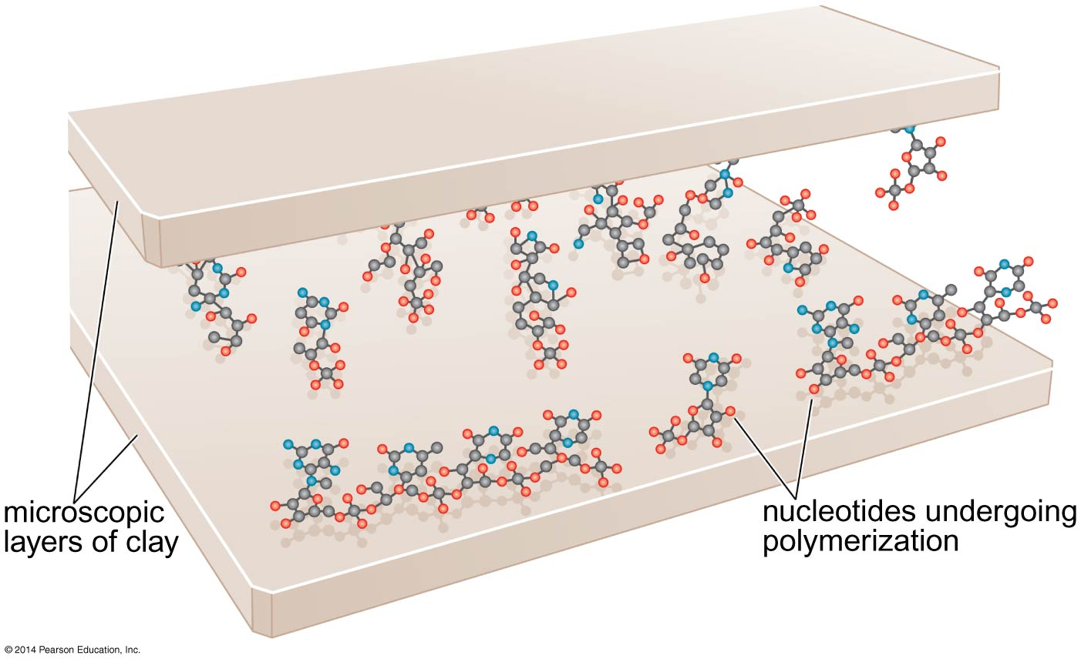
Postulated role for clay in polyribonucleotide synthesis.
Clay minerals have been shown to promote phosphodiester- bond formation by binding and concentrating nucleotides.
Microscopic layers of clay mineral may have played a similar role in the origin of life in the formation of the first polyribonucleotides.
Notes:
Figure 17-6

Slide 11
Certain meteorites known as chondrites (meaning that they had not undergone melting during their formation) are sometimes found to be carbon-containing (carbonaceous chondrites).
Chemical analyses have revealed the presence in these carbonaceous chondrites of racemic mixtures (containing both L- and D-chirality molecules) of numerous amino acids, including those found in contemporary proteins.
One large and well studied carbonaceous chondrite, the Murchison meteorite, which landed in Murchison, Australia in 1969, is particularly rich in organic molecules.
Intriguingly, among the amino acids identified in the Murchison meteorite and other carbonaceous chondrites are some, such as isovaline, that are recovered with an enantiomeric excess of L to D chirality.

Slide 12
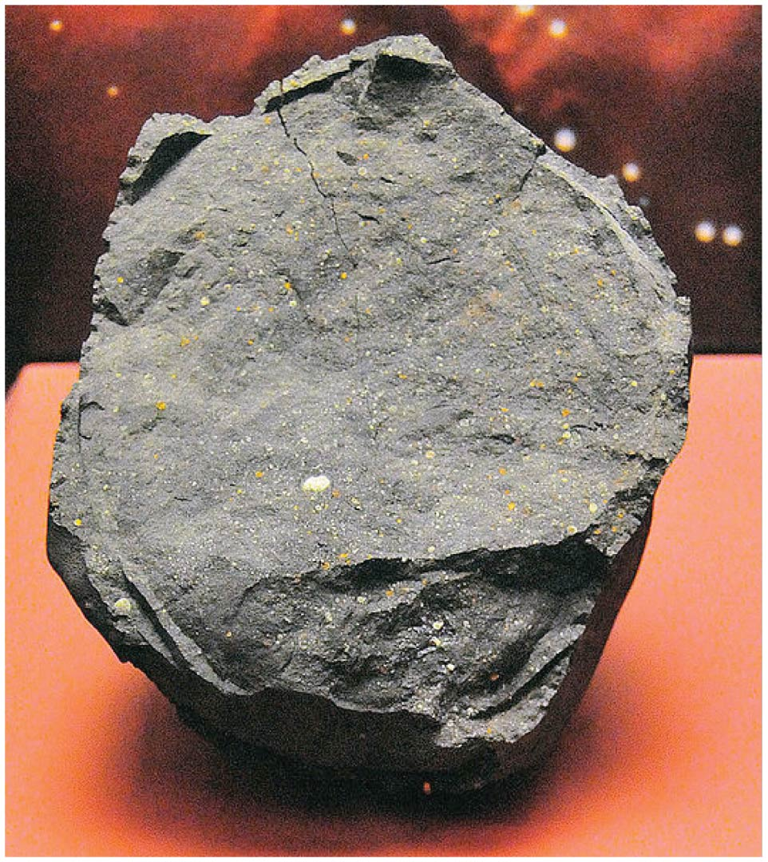
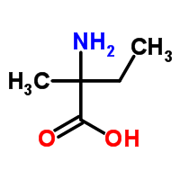
Isovaline
Notes:
Figure 17-7

Slide 13
Did Life Evolve From RNA World?
The discovery that some RNAs (ribozymes) catalyze enzymatic reactions led to the RNA World hypothesis, which holds that protein-based life arose from a primordial life-form in which RNA served both as an information carrier and an RNA polymerase ribozyme that was capable of self-replication.
In time, self-replicating RNA molecules would have evolved the capacity to produce proteins, giving rise to the contemporary Protein World.
The contemporary peptidyl transferase ribozyme, which catalyzes peptide-bond formation in the ribosome, may be a molecular fossil from the RNA World.

Slide 14
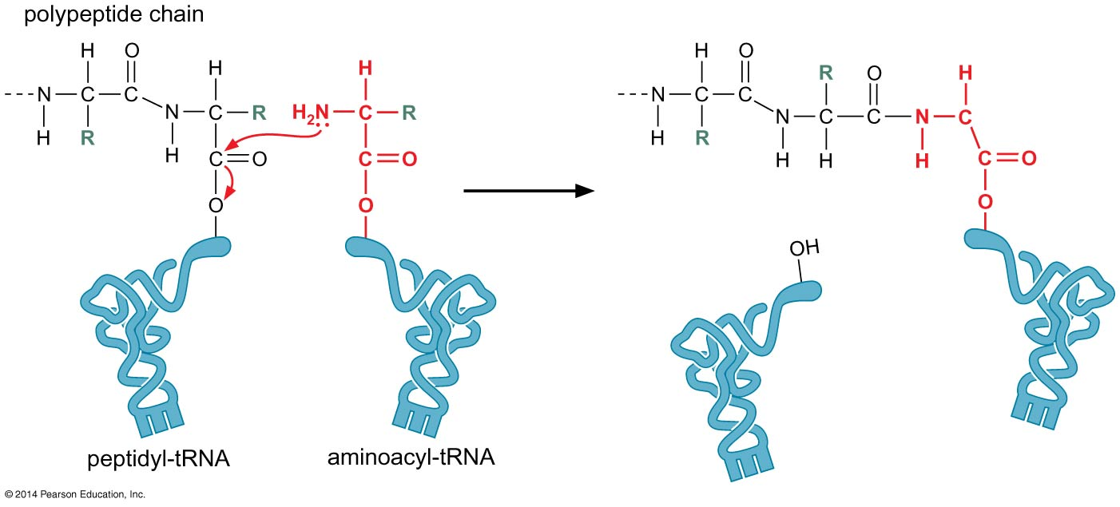
The peptidyl transferase acts on a carbon center to create the peptide bond.
Notes:
Figure 17-8

Slide 15
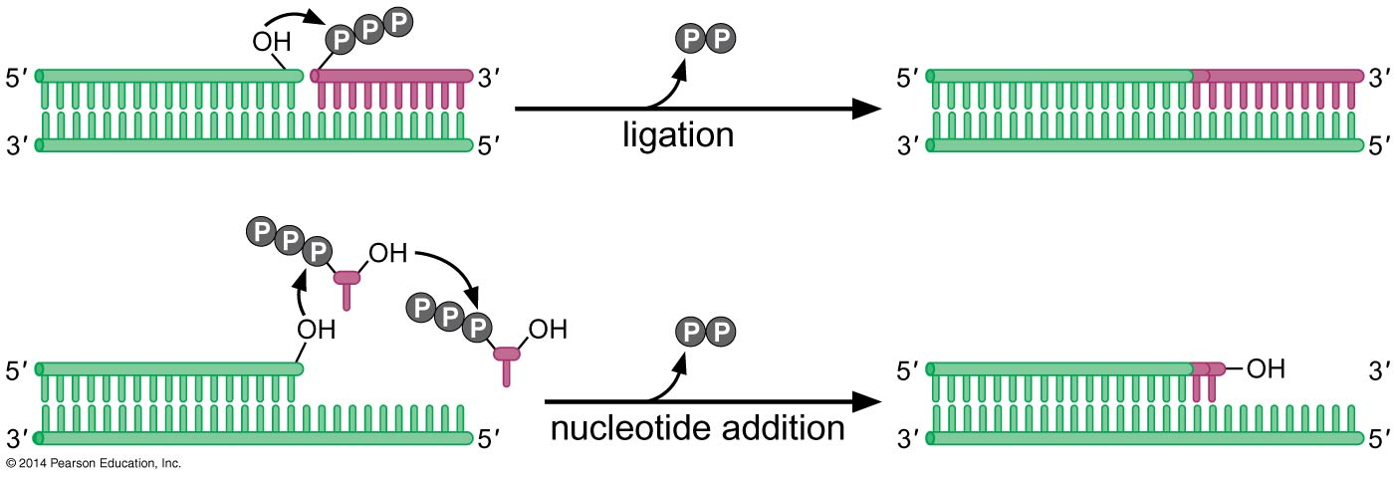
As a proof-of-principle of the RNA World hypothesis,
researchers have attempted to create ribozymes that are
capable of self-replication using methods of directed evolution (Ligation).
So far, these efforts have culminated in the creation of
RNA polymerase ribozymes that can synthesize RNA chains
as long as 95 nucleotides in a template-dependent manner.
Notes:
Figure 17-9

Slide 16
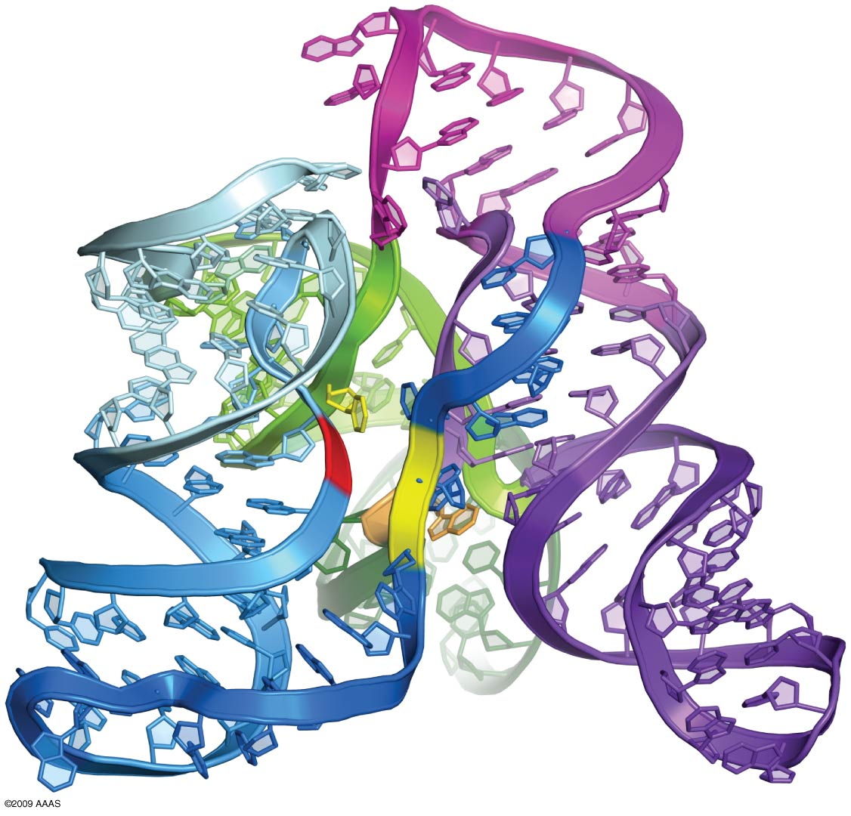
Structure of an evolved RNA ligase ribozyme:
The tripod-like crystal structure shows the three domains in blue, pink, and purple with catalytic center (yellow) and ligation site (red).
Notes:
Figure 17-10
©2009 AAAS
http://www.sciencemag.org/content/326/5957/1271.abstract

Slide 17
Replicase ribozyme
It seems difficult to imagine that a single RNA molecule could simultaneously serve as a template for its own duplication and as the polymerase that is doing the copying.
Instead, it is likely that the primordial replicase ribozyme would have had to make a copy of a sister molecule.
This would have temporarily generated an RNA–RNA duplex with two complementary strands, one being the replicase and the other being the complement of the replicase.
Additional rounds of copying of the complement would generate more replicases, whereas additional rounds of copying of the replicase strand would generate more copies of the complement, which would, in turn, serve as templates for generating additional replicases.

Slide 18
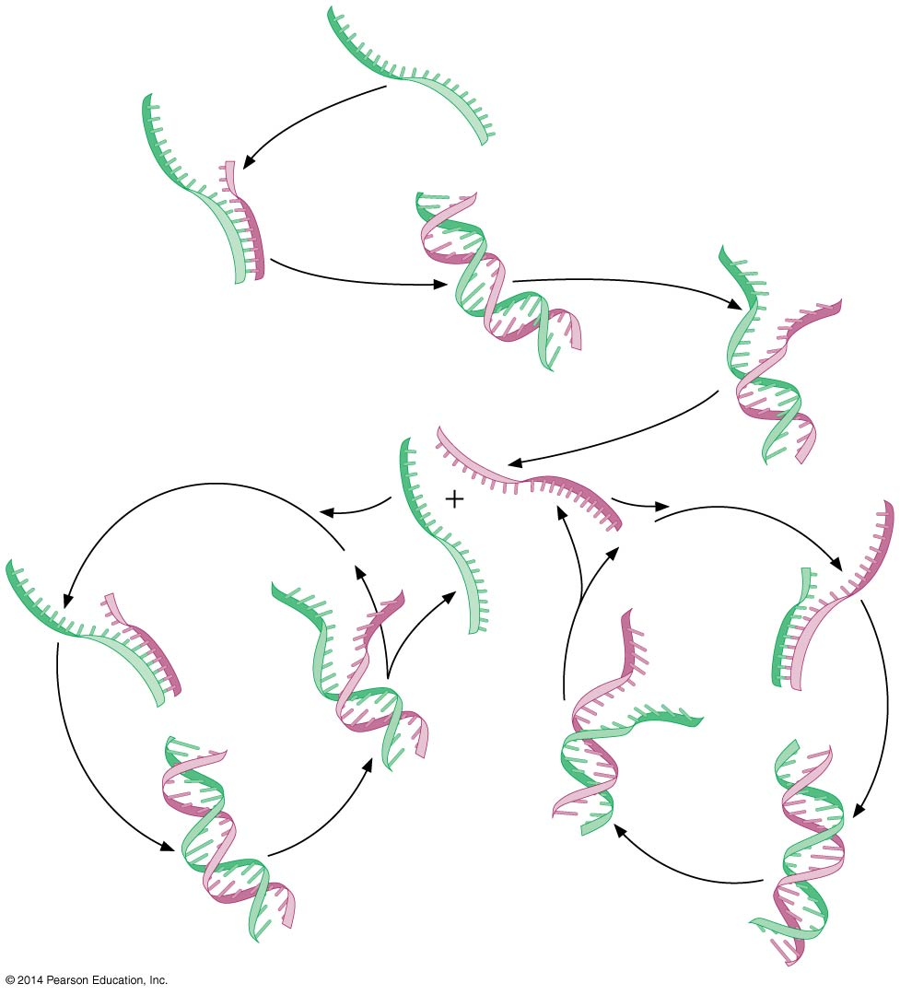
The primordial replicase ribozyme would have copied its complement.
Notes:
Figure 17-11

Slide 19
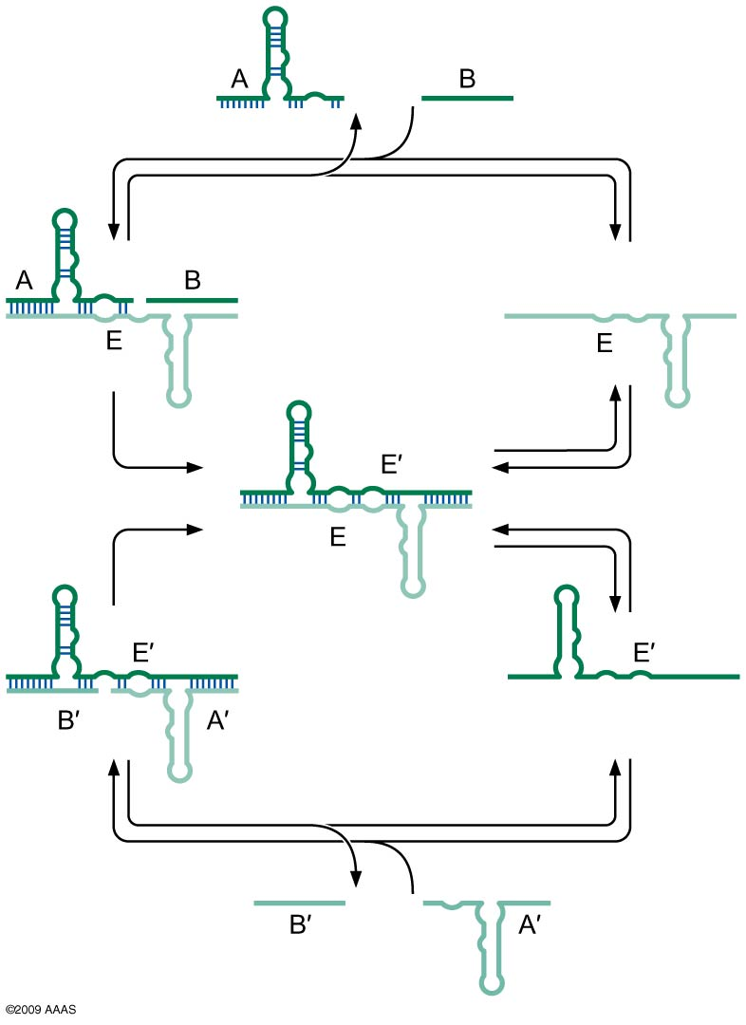
Figure 17-12
A self-sustaining replicating ribozyme.
Notes:
Figure 17-12
©2009 AAAS
http://www.sciencemag.org/content/323/5918/1229.abstract

Slide 20
Does Darwinian Evolution Require Self-Replicating Protocells?
A self-replicating system that is also subject to Darwinian evolution may have required cell-like compartments that were capable of growth and division.
Such protocells may have arisen from lipid vesicles composed of fatty acids or other amphiphiles, which can grow by accretion of fatty acids and can fragment into daughter protocells.
Thus, the earliest form of life may have been vesicle-life compartments that encapsulated replicase ribozymes and that were capable of evolving through mutation and natural selection for more rapidly propagating protocells.

Slide 21
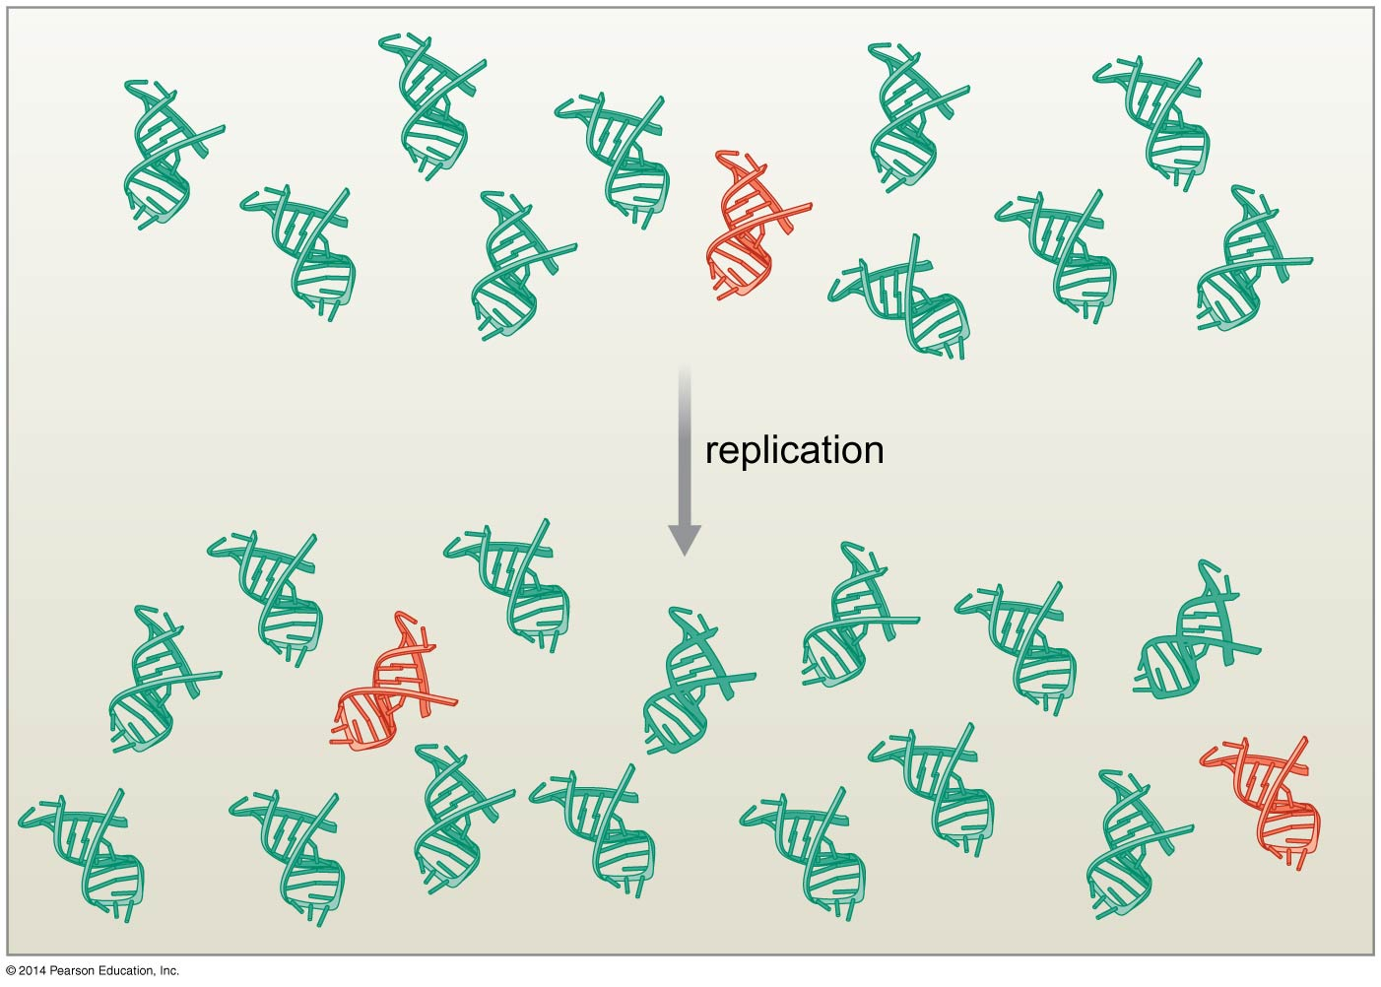
Improved mutant replicase ribozymes would have no selective advantage in the primordial soup.
Notes:
Figure 17-13

Slide 22
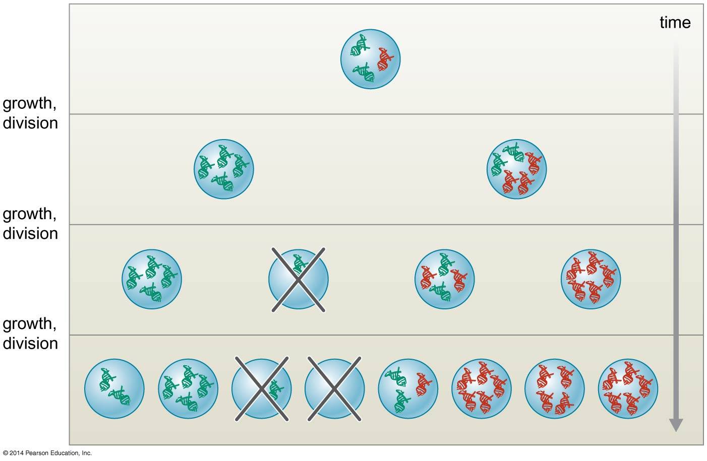
Compartmentalization permits Darwinian selection.
Notes:
Figure 17-14

Slide 23
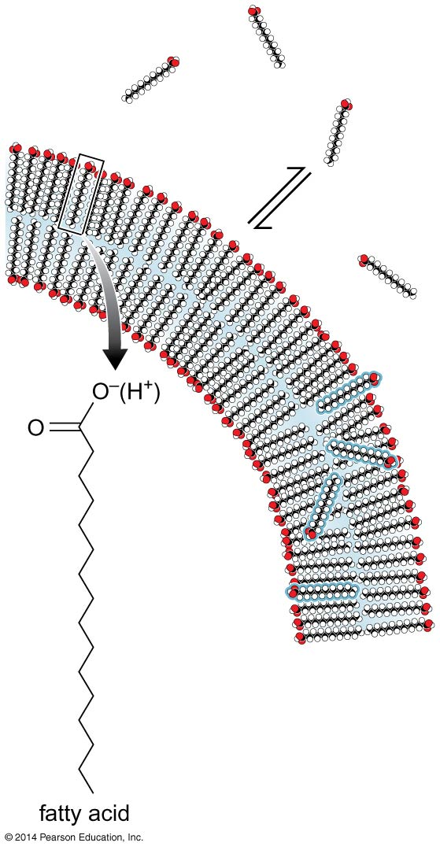
Remarkably, cell-like compartments with the properties invoked for early
life are relatively easy to generate in the laboratory.
Simple lipids such as fatty acids (and other amphiphiles), which are components of the phospholipids found in the membranes of contemporary cells, have the capacity to spontaneously form tiny, topologically closed sacs known as vesicles in aqueous environments.
Lipid does not form Ploymers
Notes:
Figure 17-15

Slide 24
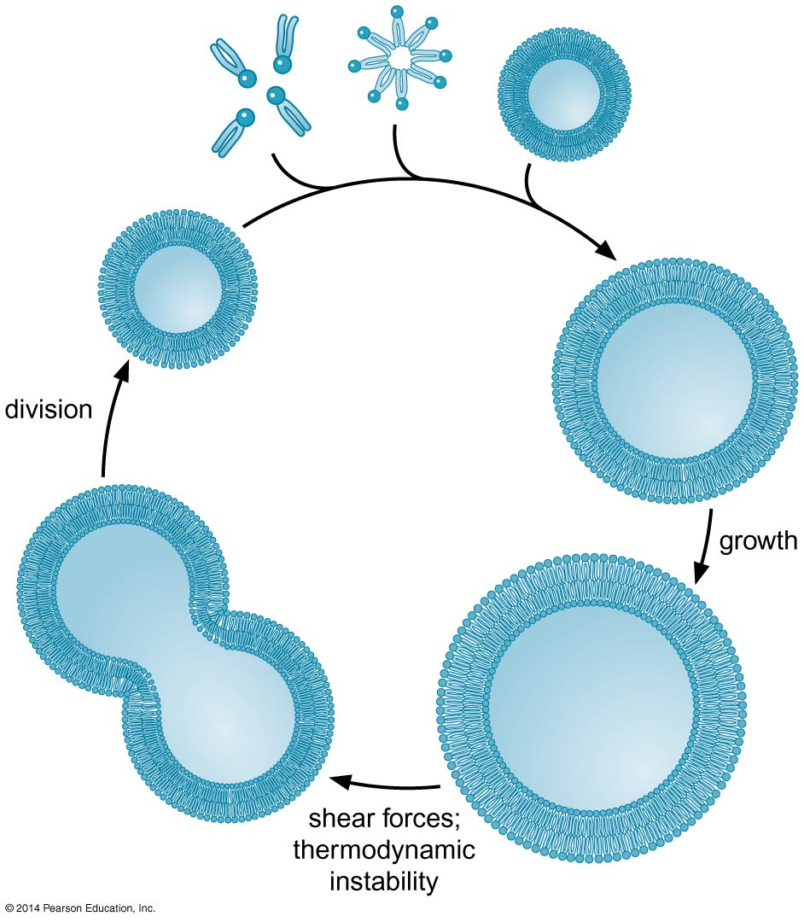
Growth and division of lipid vesicles.
Notes:
Figure 17-16

Slide 25
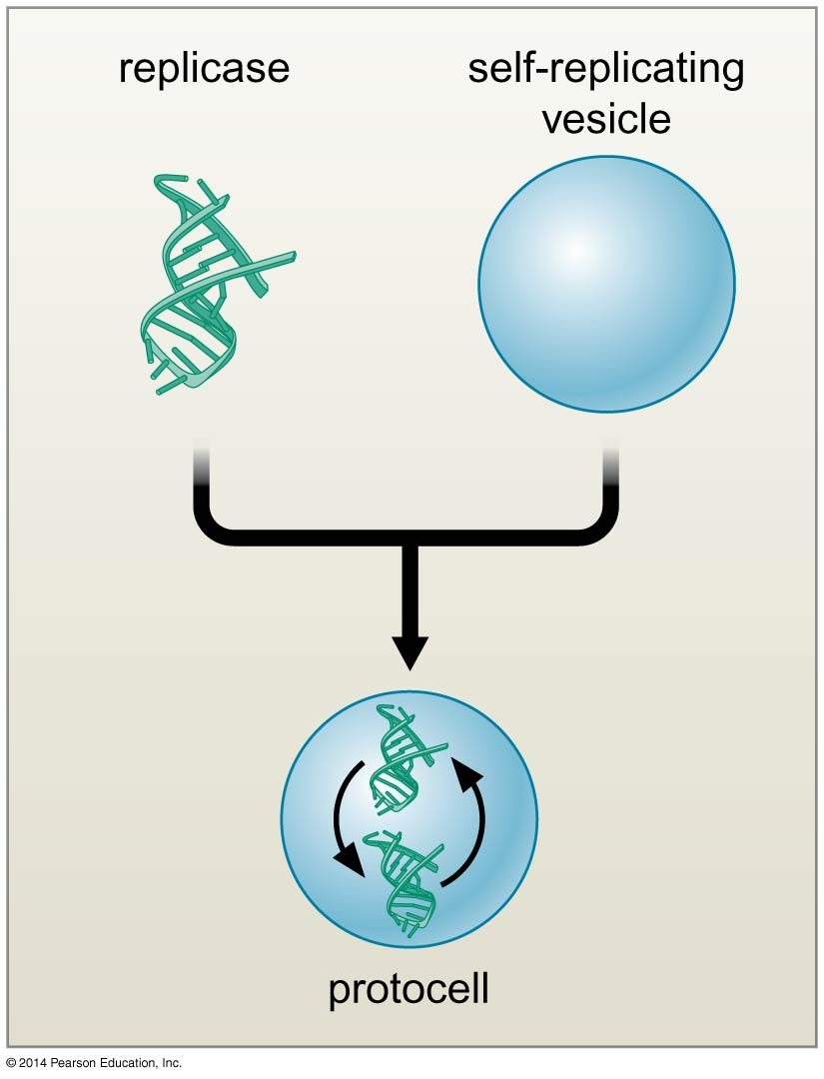
The Recipe is Ready:
primordial cell that combines self-replicating ribozymes with self-replicating vesicles.
Notes:
Figure 17-17

Slide 26
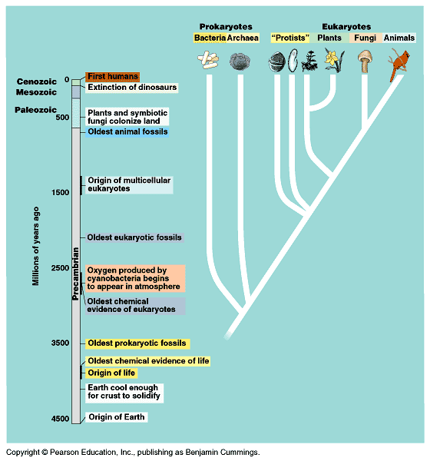
Some major episodes in the history of life.

Slide 27
1. The earth was formed ~4.5 billion years ago
2. It took ~500 million years for the crust to solidify.
3. The oldest fossils of microorganisms
  3.5 billion years old,
  embedded in rocks in western Australia
  3a. Prokaryotes dominated from 3.5 to 2 billion years ago.
  - During this time, the first divergence occurred:
  Bacteria and Archae.
Fossilized evidence of bacteria
→ Stromatolites are fossilized bacterial mats. Many fossils of prokaryotes are found in layers that make up the prokaryotic mats.

Slide 28
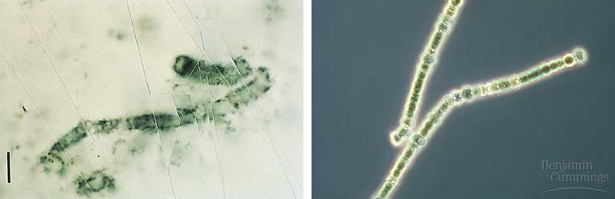
Early and modern prokaryotes

Slide 29
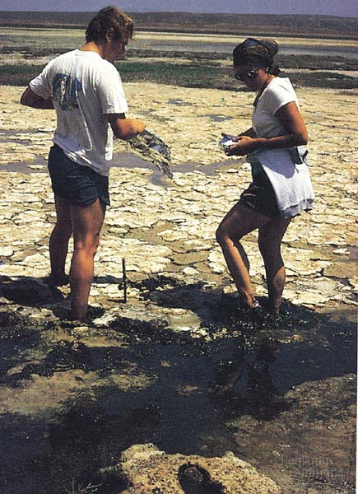
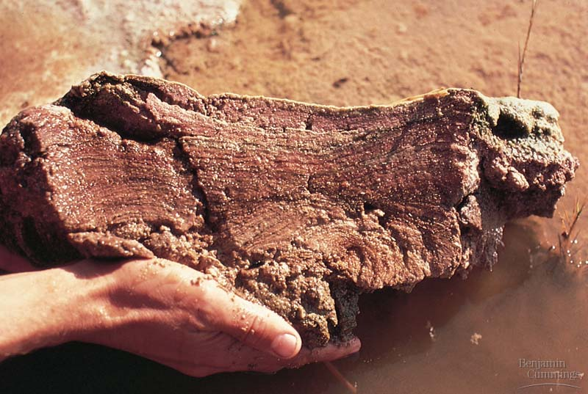
Bacterial mats and stromatolites

Slide 30
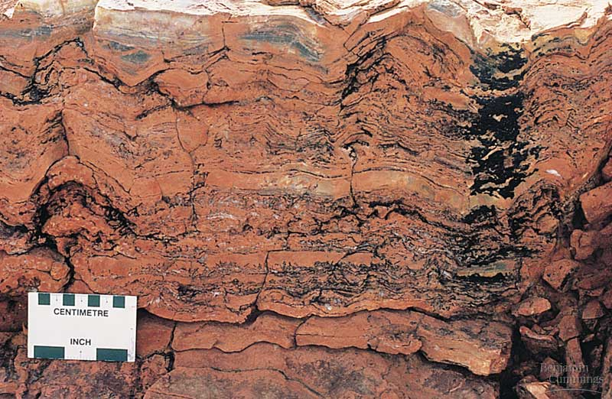

Slide 31
4. Oxygen began accumulating in the atmosphere about 2.7 billion years ago.
  a. Cyanobacteria are photosynthetic prokaryotes that are still present today → produced oxygen.
5. The oldest eukaryotic fossils are ~2 billion years old.
  a. Symbiotic community of prokaryotes living within larger prokaryotes.
  → Mitochondria and chloroplasts
6. The oldest fossils of multicellular organisms are ~1.2 billion years old.

Slide 32
7. The oldest animal fossils are ~700 million years old.
  a. Animal diversity exploded ~540 million years ago.
8. Plants, fungi, and animals began colonizing land ~500 million years ago.
a. First plants transformed the landscape…
b. Then animals were able to take advantage of new niches.
  → Mammals evolved 50 to 60 million years ago.

Slide 33
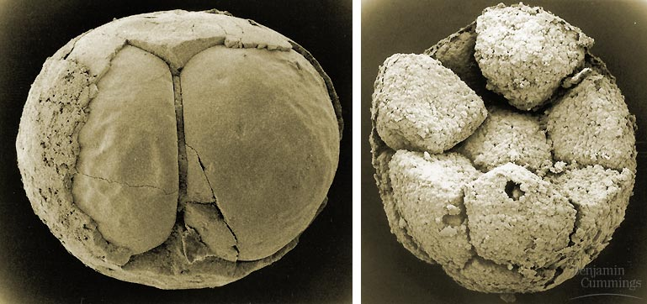
Oldest Fossilized animal embryos from Chinese sediments 570 million years ago.

Slide 34
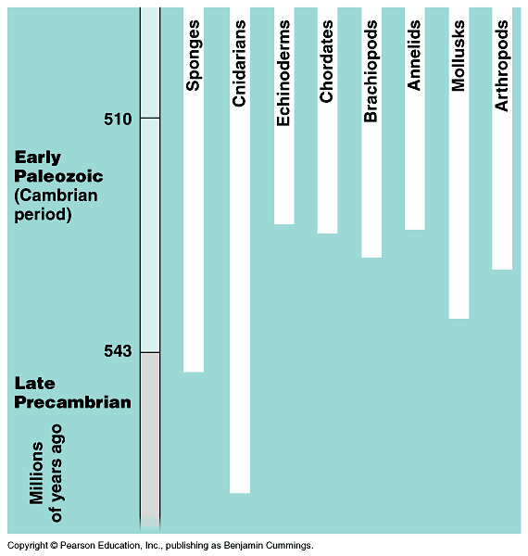
The Cambrian radiation of animals

